Slide 1

REAL TIME COLLABORATIVE CODE EDITOR
Notes:
Notes for slide1

Slide 2

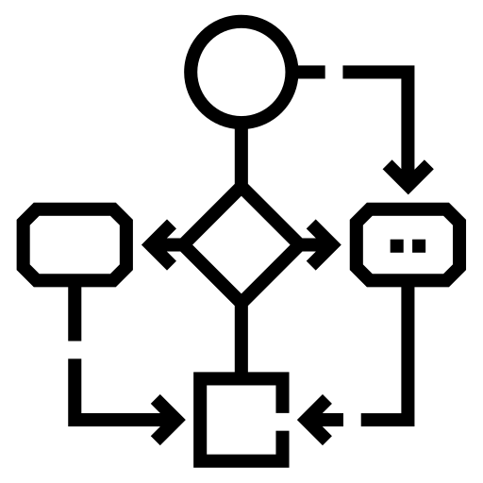


AGENDA
TECH STACK
USED
FEATURES
1
3
2
4
IDEA BEHIND
OUR PROJECT
ARCHITECTURE

Slide 3
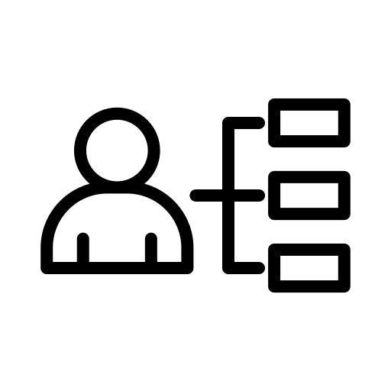


AGENDA
FUTURE SCOPE
5
7
6
USE CASES
CONCLUSION

Slide 4




Slide 5

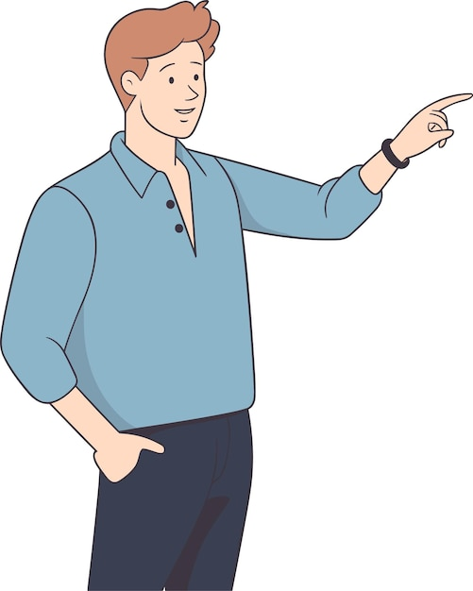

G
1 : IDEA BEHIND OUR PROJECT
1. What is Traditional Code Editing?
2. Benefits Of Traditional Code Editing?
3. Drawbacks of Traditional Code Editing?
4. Solution for the drawbacks of Traditional Code Editing?
Page 1 of 3

Slide 6
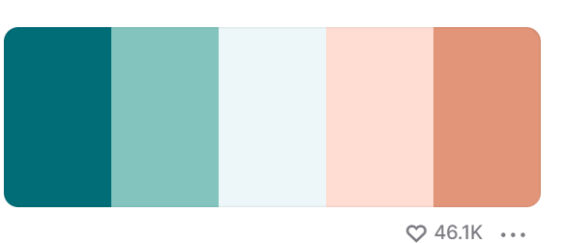
G
TRADITIONAL CODE EDITING
PROS
CONS
Familiarity with text
editors and IDEs
Manual Version Control
2. Debugging can be more
time-consuming
2. Lightweight and fast for
small projects
3. Difficulty in coordinating
large team projects
3. Customizable environment
4. Not Ideal for Teamwork
4. Works offline without
internet dependency
5. Less Availability of
automatic tools
5. Seamless integration
with local tools
6. Delay in feedbacks
Page 2 of 3

Slide 7

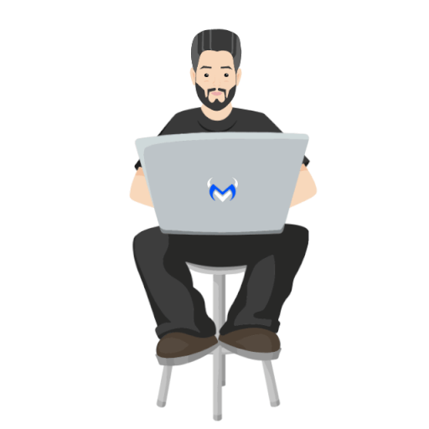
G
SOLUTION : Realtime Collaborative Code Editing
Name : Tom
Company Name: XYZ,Location : Vadodara
Name : Nick
Company Name: XYZ, Location : Bangalore
Hello nick! I am facing error in the Python code please help me. My code contains 1000 LOC ,so not able to send the whole file.
Okay ! I’m sending you the RoomID for codEdit editor so please join into the Room and thus we both can make changes to the code & find the error!!
A collaborative code editor is like a digital workspace where multiple people can work on writing or editing code together at the same time, no matter what the geographic location is . It's like having everyone in the same virtual room, typing away and making changes to the code in real-time.
Page 3 of 3

Slide 8
G
2 : FEATURES
1
2
3
4
Real-time Editing
Real-time Chat
Syntax Higlighting
Chatbot
Assistance
7
8
5
6
Code Snippet Search
Saving the code file
Code Auto-Suggestion
Compilation

Slide 9

3 :ARCHITECTURE
G

Slide 10
G
Topics Covered in Architecture section:-
Components of Collaborative Code
Editor
HTTP vs WebSocket
How real-time code manipulation works?
How real-time chat works?
How code is getting compiled?
1

Slide 11
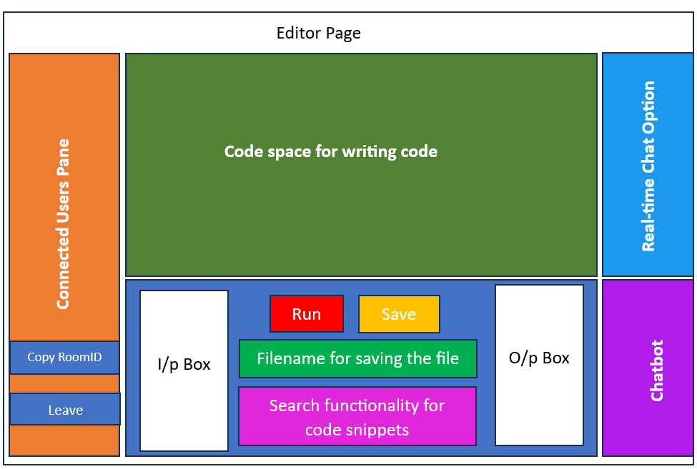
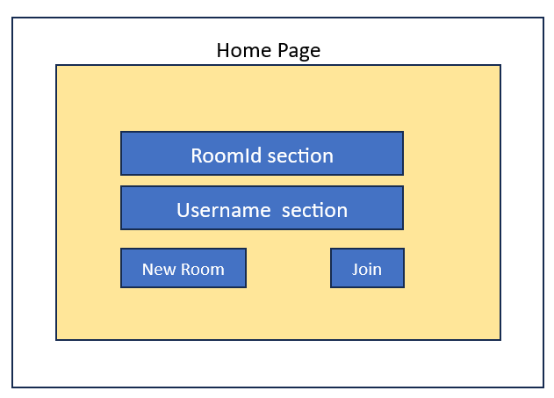
G
Components of CodEdit
2.) Editor Page :
Home Page
Editor Page
1.) Home Page :
2
3

Slide 12
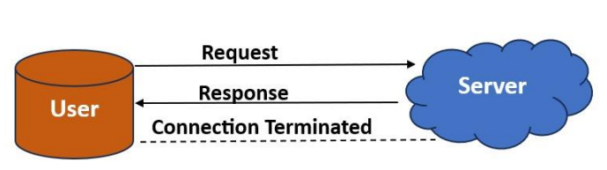
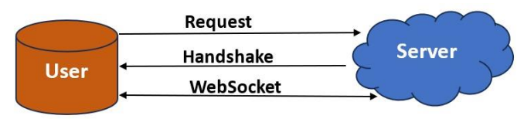
G
HTTP vs WebSocket
server will keep alive until it is terminated by either party (client or server). After closing the connection by either of the client and server, the connection is terminated from both ends.
HTTP Protocol
HTTP is unidirectional where the client sends the request and the server sends the response.
WebSocket
WebSocket is bidirectional, a full-duplex protocol that is used in the same scenario of client server communication. It is a stateful protocol, which means the connection between client and
4
5

Slide 13
G
How real-time manipulation works
2.) Now server will send notification
msg to all other users in the room
with the username of new user.
1.) User sends request to server and
connection is established. And unique
socket id is assigned to each user for
better identification.
2- Notification sent to other users with username
User1
2 – Connection Established
Server
RoomID :ABC
User
1 - request
Server
User2
1 – User3 clicks on join to
enter the room
3 – Unique Socket-id assigned
User3
6
7

Slide 14
G
--
3. System has to make sure that new
user should be able to see the code
which has been already written by
other users present in the room as
soon as the new user clicks on join
button.
4. Now all the users are present in the
room, so users should be able to see
the changes in code done by other user
in real-time.
Server
Server
Code-change
Code-change
Sync-code
Already written code by user1
---------------------------------
---------------------------------
---------------------------------
---------------------------------
User2 Codespace
User1 Codespace
User2 Codespace
User1 Codespace
9
8

Slide 15

G
--
5. When user clicks on leave button the
connection between that user and
server gets disconnected and server will
notify all other remaining users in the
room that user has left.
How real-time chat works?
When a particular user sends message in chat, it will be received by server. Now server will broadcast that message to users present in that room with the username of sender
Server
Server
User-1 has left
Hello
Hello
Hello
User1
User2
User3
User1
User2
User3
RoomID :ABC
RoomID :ABC
10
11

Slide 16
G
--
How code is compiled?
3.
1.
Compiled O/p
------------------------------------
----------------------------------
Code
Fetch o/p
Compiled o/p
FrontEnd
(Code Editor)
FrontEnd
(Code Editor)
API
(BackEnd)
API
(BackEnd)
2.
4.
Display
O/p
Code
Compilex
FrontEnd
(Code Editor)
Compiled O/p
API
12
13
Notes:
1. We utilized Compilex, a Node.js library, for building online code compiler and interpreter websites and services.2. We set up an API route to receive code input from users written in the editor.3. Within the API, we employed Compilex to compile the code received from the front-end.4. Compilex then provides the compiled output, which we can display to the user on the front-end.

Slide 17
G

Slide 18
G
4 : TECH STACK USED
(A) MAIN TECHNOLOGIES USED
NodeJS
HTML
Technologies
Socket.io
CSS
Front End
Back End
ReactJS
ExpressJS
Page 1 of 2

Slide 19
G
(A) OTHER TECHNOLOGIES USED
CODEMIRROR
COMPILEX
CODEBASE
Page 2 of 2

Slide 20
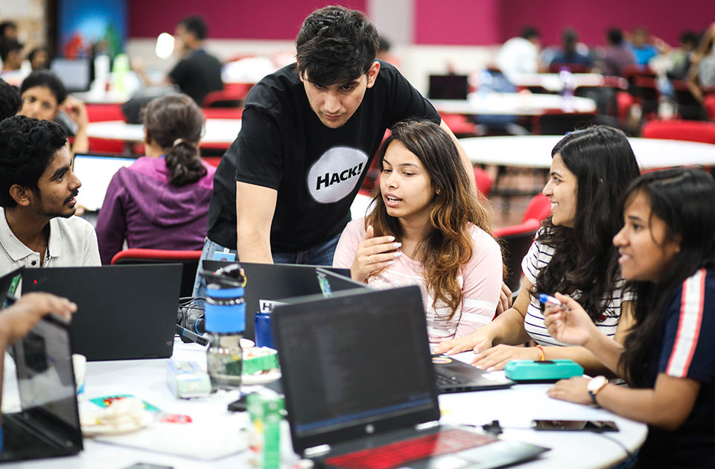

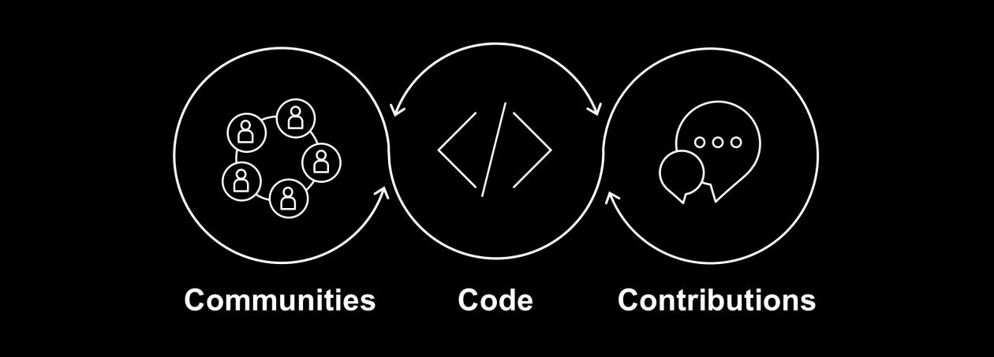

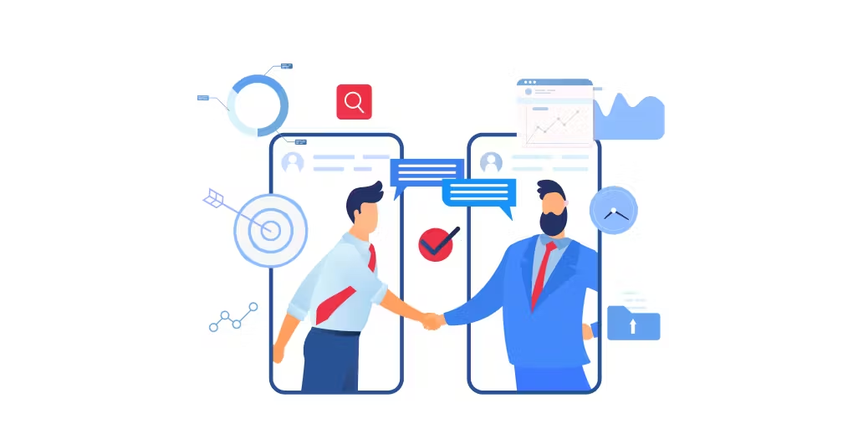
G
5 : USE CASES
Hackathons and Coding Competitions
Mentoring and Learning
Open Source Contributions
Interviewing
Client Collaboration

Slide 21
G
6 : FUTURE SCOPE
1
Allowing Users to share files via Chat
2
Allowing Users to work on multiple programming languages
3
User-Authorization & Authentication
4
Enable users to share RoomID via Whatsapp, Email,etc..
Slide 6
5
Addition of version control functionality to get updates of each and every update of code-change

Slide 22

G
7 : CONCLUSION
CONCEPTS DISCUSSED:
Importance of Collaborative Code Editor
Crucial Features included in codEdit
Functional Working of codEdit
Real-life use cases of codEdit
Discussion of Future developments
Page 1 of 2
Notes:
Hello this is the last slide

